Slide 2

Ayudando a reducir
el endeudamiento
en países pobres

Slide 3

HIPC
Amplio y rápido
alivio a países
pobres muy
endeudados
Los países tienen
que alcanzar el
punto de
decisión
1996
Heavily Indebted Poor
Iniciativa de Países Pobres
Countries Initiative
Altamente Endeudados
MDRI
Dar más apoyo a
los países HIPC
para alcanzar
Los MDG’s
Los países tienen
que alcanzar el
punto de
cumplimiento
2006
Multilateral Debt
Iniciativa Multilateral de
Relief Initiative
Alivio de la Deuda
Notes:
Completion Point
(32 countries) Afghanistan, Benin, Plurinational State of Bolivia, Burkina Faso, Burundi, Cameroon, Central African Republic, Republic of Congo, Democratic Republic of Congo, Ethiopia, The Gambia, Ghana, Guinea-Bissau, Guyana, Haiti, Honduras, Liberia, Madagascar, Malawi, Mali, Mauritania, Mozambique, Nicaragua, Níger, Rwanda, São Tomé Príncipe, Senegal, Sierra Leone, Tanzania, Togo, Uganda, Zambia,
Countries reach the completion point if they maintain macroeconomic stability under an ECF-supported program, carry out key structural and social reforms, and satisfactorily implement for a minimum of one year a Poverty Reduction Strategy. Debt relief is then provided irrevocably by the country’s creditors. MDRI relief is provided upon reaching the completion point.
Decision Point
(4 countries) Chad, Comoros, Côte d’Ivoire, Guinea
Countries reach the decision point if they have a track record of macroeconomic stability, have prepared a Poverty Reduction Strategy through a participatory process, and have debt burden indicators above the HIPC initiative thresholds using the most recent data for the year immediately prior to the decision point. The amount of debt relief necessary to bring countries’ debt indicators to HIPC thresholds is calculated, and countries begin receiving interim debt relief on a provisional basis.
Pre-Decision Point
(3 countries) Eritrea, Somalia, Sudan
Countries that have been assessed to meet the income and indebtedness criteria at end-2004 and wish to avail themselves of the HIPC Initiative.
KyRGYZ REPUBLIC. The Kyrgyz authorities indicated in early 2007 that they did not wish to avail themselves of debt relief under the HIPC Initiative but subsequently expressed interest in the MDRI. This table does not list those countries that indicated that they did not wish to avail themselves of assistance under the Initiative, either at the time of the 2006 ring-fencing (Bhutan and Lao PDR) or later (Nepal).

Slide 4
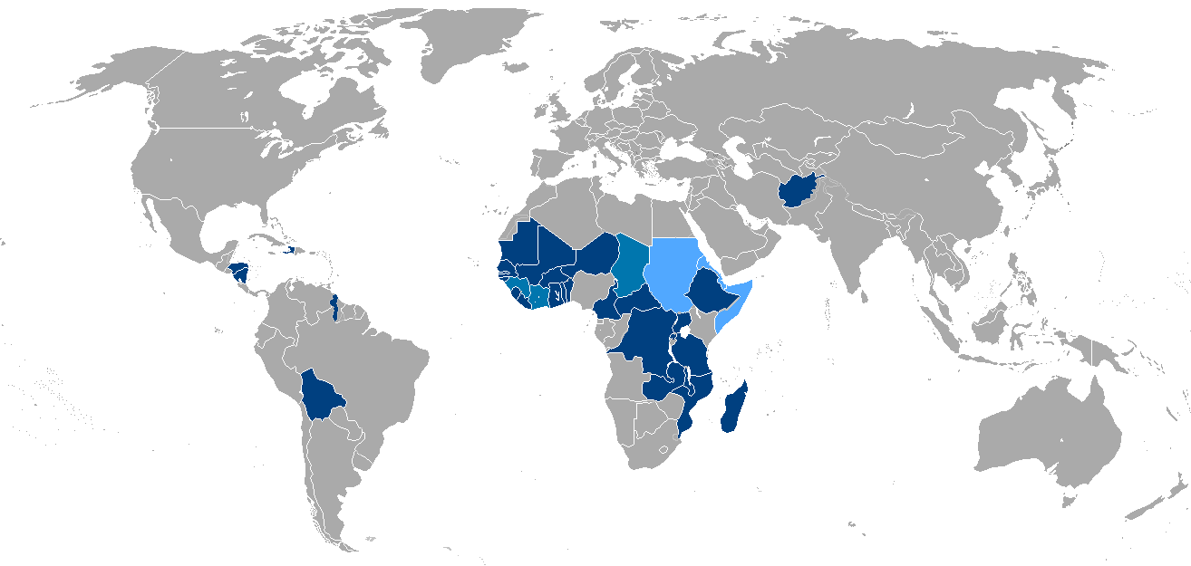
39 países favorecidos
32
Punto de cumplimiento
4
Punto de decisión
3
Pre punto de decisión
Notes:
Initially, 19 countries are expected to receive 100 percent cancellation of their eligible debt: Benin, Bolivia, Burkina Faso, Cameroon, Ethiopia, Ghana, Guyana, Honduras, Madagascar, Mali, Mauritania, Mozambique, Nicaragua, Niger, Rwanda, Senegal, Tanzania, Uganda and Zambia.
There is no new conditionality, but “once-off” assessments were conducted for the 19 HIPCs that have already reached completion point to determine whether there had been any deterioration in performance since reaching the completion point.

Slide 5
Acreedores comprometidos
HIPC and MDRI por acreedor
Valor a fines del 2010, miles de millones de dólares
Notes:
Al punto que el Ifm ha catalogado esta como una de las perores crisis….

Slide 6
Reducción de la deuda
Deuda de los países HIPC
Valor a fines del 2010, miles de millones de dólares
90%
menos
Notes:
Solo incluye a los 36 con punto de cumplimento

Slide 7
Deuda más sostenible
Indicadores de deuda en países HIPC
Porcentajes
1999
2010
Notes:
Al punto que el Ifm ha catalogado esta como una de las perores crisis….

Slide 8
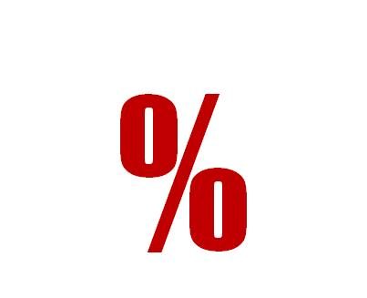

2
del PIB de
ahorro anual
en servicio

Slide 9
Más gasto pro-pobre
Gasto pro-pobre en países HIPC
Porcentaje
Notes:
Al punto que el Ifm ha catalogado esta como una de las perores crisis….

Slide 10

Retos
remanentes
Algunos países se han atrasado por su inestabilidad y debilidad institucional
Algunos acreedores no han dado el alivio
que se esperaba
Notes:
Non-Paris Club bilateral creditors as a whole have delivered around 40 percent of their share of HIPC Initiative debt relief, but about one third of these creditors have not delivered any relief at all. While there has been some increase in the delivery over the past year, the rate of delivery remains disappointingly low.
The delivery of debt relief by commercial creditors has increased markedly in recent years through a few large operations supported by IDA’s Debt Reduction Facility buyback operations .Some commercial creditors have initiated litigations against HIPCs, raising significant legal challenges to burden sharing among all creditors, including the multilateral institutions. The number of litigation cases against HIPCs has been declining in recent years but flattened over the past year.
Given the voluntary nature of creditor participation in the HIPC Initiative, the IMF and the World Bank will continue to use moral suasion to encourage creditors to participate in the Initiative and to deliver fully their share of HIPC Initiative debt relief.

Slide 11

Superar el excesivo
endeudamiento
en países pobres
Notes:
Non-Paris Club bilateral creditors as a whole have delivered around 40 percent of their share of HIPC Initiative debt relief, but about one third of these creditors have not delivered any relief at all. While there has been some increase in the delivery over the past year, the rate of delivery remains disappointingly low.
The delivery of debt relief by commercial creditors has increased markedly in recent years through a few large operations supported by IDA’s Debt Reduction Facility buyback operations .Some commercial creditors have initiated litigations against HIPCs, raising significant legal challenges to burden sharing among all creditors, including the multilateral institutions. The number of litigation cases against HIPCs has been declining in recent years but flattened over the past year.
Given the voluntary nature of creditor participation in the HIPC Initiative, the IMF and the World Bank will continue to use moral suasion to encourage creditors to participate in the Initiative and to deliver fully their share of HIPC Initiative debt relief.

